Slide 1
Cotiviti Internship NLP POC
Kolton Hauck
5/24/2023

Slide 2
EHRs: Structured & Unstructured

Slide 3
EHRs: Structured & Unstructured
Unstructured clinical narratives are essential to “solving 59% of the CLL trial criteria and 77% of the prostate cancer trial criteria” for patient recruitment in a clinical trial
Raghavan, Preethi, et al. “How Essential Are Unstructured Clinical Narratives and Information Fusion to Clinical Trial Recruitment?” AMIA Summits on Translational Science Proceedings, vol. 2014, American Medical Informatics Association, 2014, p. 218, /pmc/articles/PMC4333685/
“All seven social characteristics were identified at the highest rates in physician notes. For example, we identified 14,872 patient admissions with poor social support in physician notes, increasing the prevalence from 0.4 percent using ICD-9 codes and structured EHR data to 16.0 percent.”
Navathe AS, Zhong F, Lei VJ, Chang FY, Sordo M, Topaz M, Navathe SB, Rocha RA, Zhou L. Hospital Readmission and Social Risk Factors Identified from Physician Notes. Health Serv Res. 2018 Apr;53(2):1110-1136. doi: 10.1111/1475-6773.12670. Epub 2017 Mar 13. PMID: 28295260; PMCID: PMC5867172

Slide 4
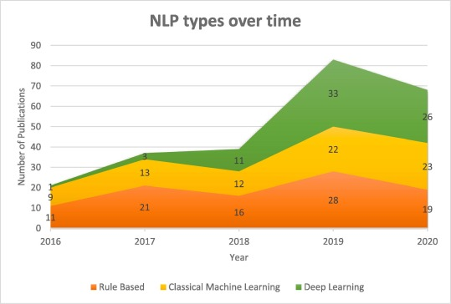
NLP Approaches
Rules-Based
NLTK
spaCy
RegEx
NegEx
Machine Learning
SVM
Random Forests
GLMs
Bayesian Networks
TF-IDF
Deep Learning
RNN
LSTM
BERT
Word2vec
LLM
https://doi.org/10.1016/j.ijmedinf.2022.104779

Slide 5
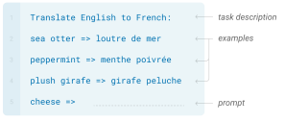
Large language models
Open Source
BigScience
LLaMA
Flan-T5
GPT-J
Proprietary
OpenAI
co:here
AI21 Labs
Anthropic
LangChain
Models
Chains
Indexes
Memory
Agents
Prompts
Few shot
https://arxiv.org/pdf/2005.14165.pdf

Slide 6
LLM zero-shot POC for ICD-10 coding
Using LangChain
Model: OpenAI’s Davinci-003
Zero-Shot
6 examples
Clinical Narrative
He is a 24-year-old male who said that he had gotten into some poison ivy this weekend while he was fishing. He has had several cases of this in the past and he says that is usually takes quite awhile for him to get over it; he said that the last time he was here he got a steroid injection by Dr. Blackman; it looked like it was Depo-Medrol 80 mg. He said that it worked fairly well, although it seemed to still take awhile to get rid of it. He has been using over-the-counter Benadryl as well as cortisone cream on the areas of the rash and having a little bit of improvement, but this last weekend he must have gotten into some more poison ivy because he has got another outbreak along his chest, legs, arms and back.
https://huggingface.co/datasets/Elfsong/ClinicalDataset/viewer/Elfsong--ClinicalDataset
Prompt
Given the following patient description, give any ICD-10 diagnoses present: '{description}’
Output the information as a table, including the probability of the diagnosis (high/medium/low). Schema: Diagnosis | ICD-10 Code | Probability
Also, include any medications that have been or are currently being used and whether the drug is currently being used or has been used and the RxNorm Concept Unique Identifier (RxCUI) code for the medication as a table. Schema: Drug Name | RxCUI | Current/Previous

Slide 7
LLM zero-shot POC for ICD-10 coding
Clinical Narrative
Diagnosis | ICD-10 Code | Probability
Poison ivy dermatitis | L23.9 | High
Prompt
Model
Drug Name | RxCUI | Current/Previous
Benadryl | 184624 | Current
Depo-Medrol | 80928 | Previous
Prompt
Template

